Slide 1

Lang-Chain RAG
Travel Agent
GWU CSCI-6365 24FA
Shi Qiu

Slide 2
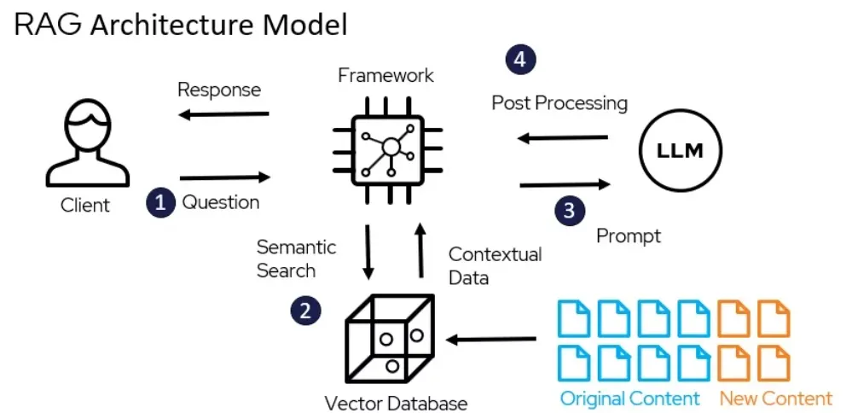

Slide 3
Process
The user asks a question.
The system uses an LLM to classify the query’s intent (hotel-related or not).
If hotel-related, it searches a hotel CSV(2.24 GB) based on extracted filters. If non-hotel-related, it uses vector-based semantic search on a Knowledge Graph.
The system collects relevant information , then prompts the LLM to generate a cohesive, helpful answer.
The user receives a final, context-informed response. The conversation continues as the user asks follow-up questions.

Slide 4


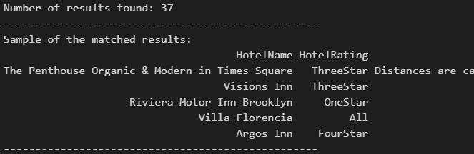
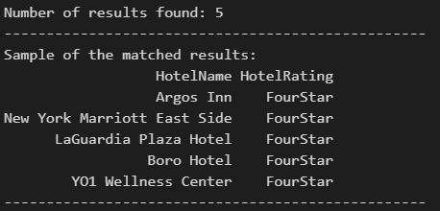
help me find a hotel in newyork
Multiple matches found (3994). Please refine your search criteria
"Enter additional requirements (e.g., 'parking', 'free wifi', etc.):"
maybe a 4 star hotel
Multiple matches found (490). Please refine your search criteria
"Enter additional requirements (e.g., 'parking', 'free wifi', etc.):"
maybe fivestar instead

Slide 5
Multiple matches found (89). Please refine your search criteria.
Enter additional requirements (e.g., 'parking', 'free wifi', etc.):
with wifi available in all areas
Multiple matches found (73). Please refine your search criteria.
Enter additional requirements (e.g., 'parking', 'free wifi', etc.):
....(more requirements)

Slide 6
Congrats, we found you a hotel: Collective Governors Island, what else do you want to know?
how can i contact them
To contact Collective Governors Island, you can reach out to them via email at hello@collectiveretreats.com or by phone at (970) 445-2033. You can also visit their website at https://www.booking.com/hotel/us/collective-governors-island.html for more information and to make reservations.
how to get there
To get to Collective Governors Island, you can take the Governors Island Ferry departing daily from Lower Manhattan and Brooklyn. The island is car-free, so it is best explored by foot or bicycle. You can also reach the island from local airports such as Newark International, LaGuardia, and JFK by taking public transportation or a taxi to the 10 South Street Ferry Terminal and then taking the Governors Island Ferry. Enjoy your stay at this peaceful oasis with endless opportunities for discovery and relaxation.

Slide 7
what can i do there
At Collective Governors Island, you can enjoy a variety of activities such as morning yoga, spa offerings, live music, cocktail hour on the sunset terrace, chef-driven farm-to-table dining, and exploring historic Governor's Island by bike. The gourmet dining experience offers a contemporary American menu with a focus on wood flame grilling. Additionally, guests can relax in the peaceful oasis and take advantage of the expansive outdoor setting. To get to Collective Governors Island, you can take the Governors Island Ferry departing daily from Lower Manhattan and Brooklyn. Enjoy your stay!
thankyou, exit
Thank you for your interest in Collective Governors Island. If you have any further questions or need assistance with booking, feel free to reach out to us at hello@collectiveretreats.com or call (970) 445-2033. Have a great day!
Thank you for using the Travel Assistant. Goodbye!

Slide 8
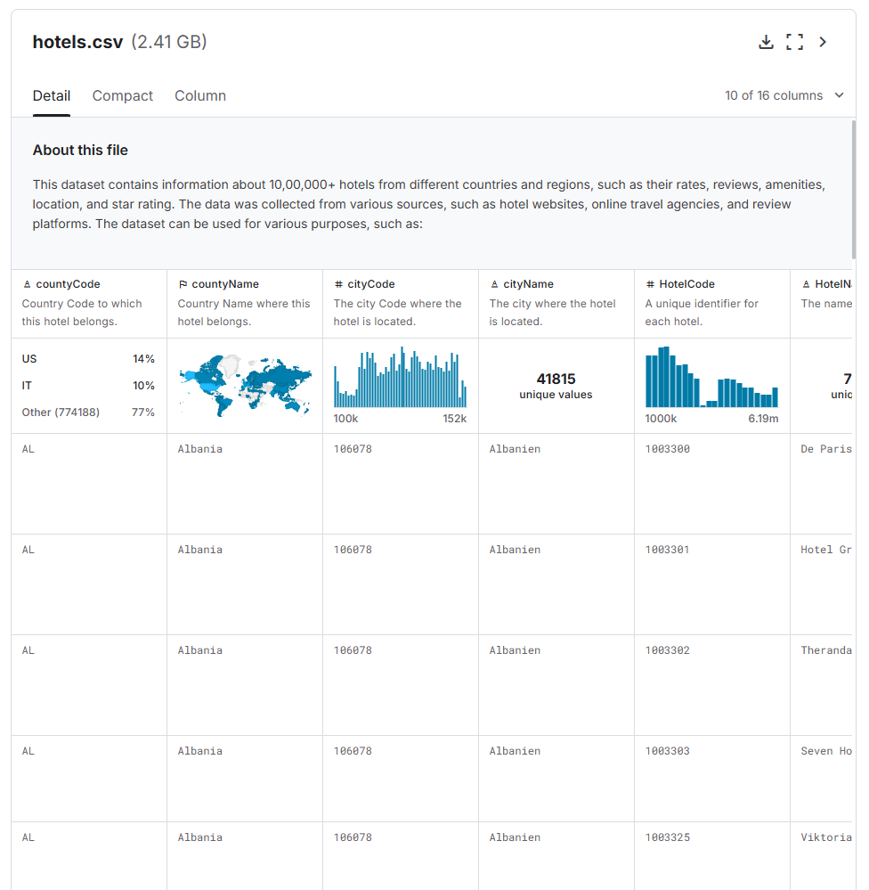
Hotel Data
Source: A structured CSV file containing information about various hotels.
Purpose: Enables fast filtering and retrieval of hotel-related information based on user queries.
Learn More
https://www.kaggle.com/datasets/raj713335/tbo-hotels-dataset

Slide 9
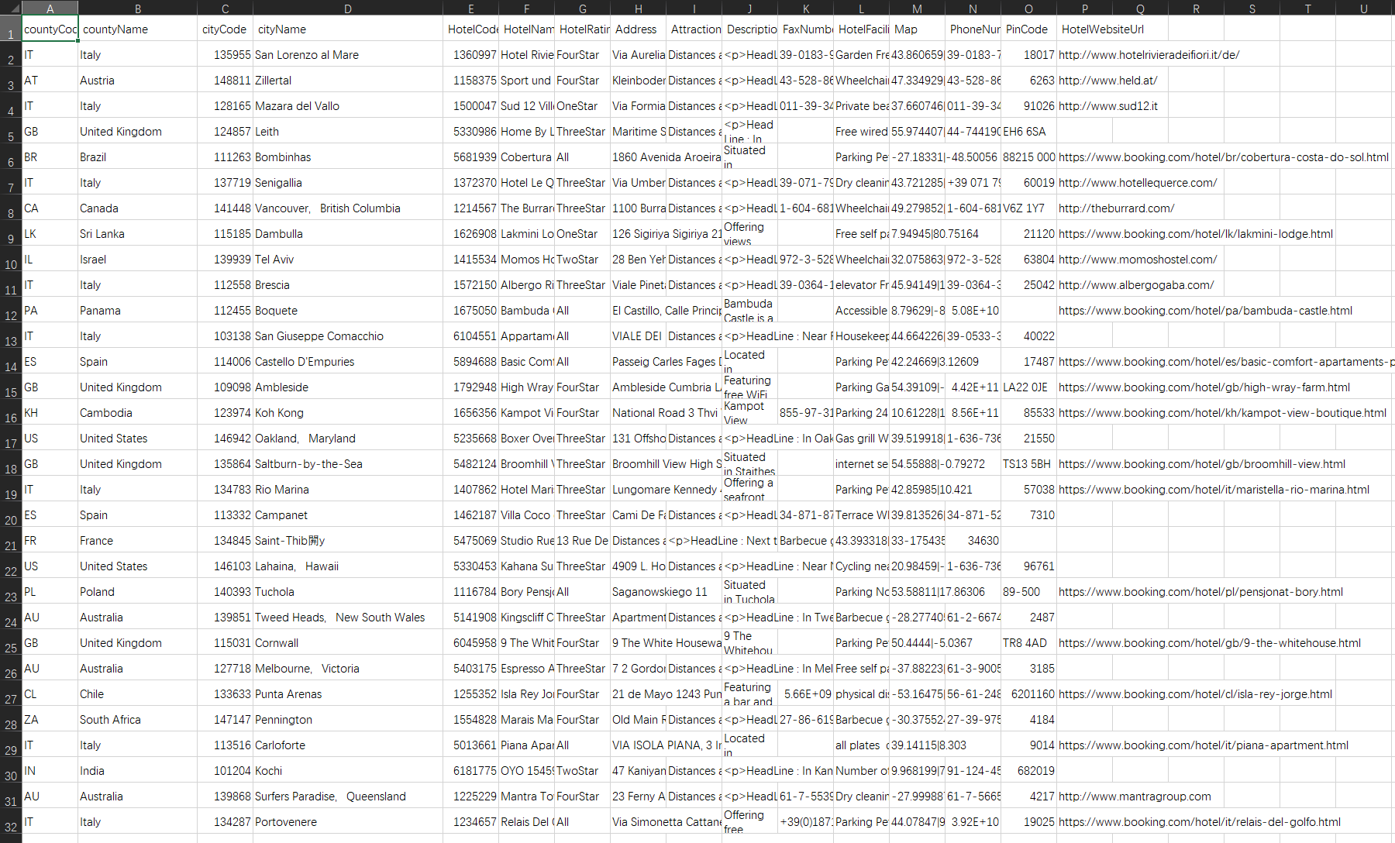
Key Columns in the Dataset
HotelName: Name of the hotel.
HotelRating: Rating of the hotel (e.g., stars).
CityName: Location of the hotel.
HotelFacilities: Facilities offered (e.g., parking, free WiFi).
Attractions: Nearby attractions.
Description: Brief description of the hotel.
PhoneNumber: Contact information.
HotelWebsiteUrl: Official website of the hotel
Learn More
https://www.kaggle.com/datasets/raj713335/tbo-hotels-dataset

Slide 10
Some Key Stats:
Key Statistics
Records: 1,009,103 entries
Unique Cities: 41,796 unique city names
Hotel Ratings Distribution:
ThreeStar: 352,451 hotels
TwoStar: 159,708 hotels
FiveStar: 22,369 hotels
Popular Cities
London: 5,941 hotels
Orlando, Florida: 5,522 hotels
Bali: 3,153 hotels
columns |  | null_values | data types
0 | countyCode | 912 | object
1 | countyName | 0 | object
2 | cityCode | 0 | int64
3 | cityName | 0 | object
4 | HotelCode | 0 | int64
5 | HotelName | 0 | object
6 | HotelRating | 0 | object
7 | Address | 102 | object
8 | Attractions | 525092 | object
9 | Description | 47005 | object
10 | FaxNumber | 560347 | object
11 | HotelFacilities | 50378 | object
12 | Map | 930 | object
13 | PhoneNumber | 327137 | object
14 | PinCode | 30979 | object
15 | HotelWebsiteUrl | 250118 | object
https://www.kaggle.com/datasets/raj713335/tbo-hotels-dataset

Slide 11
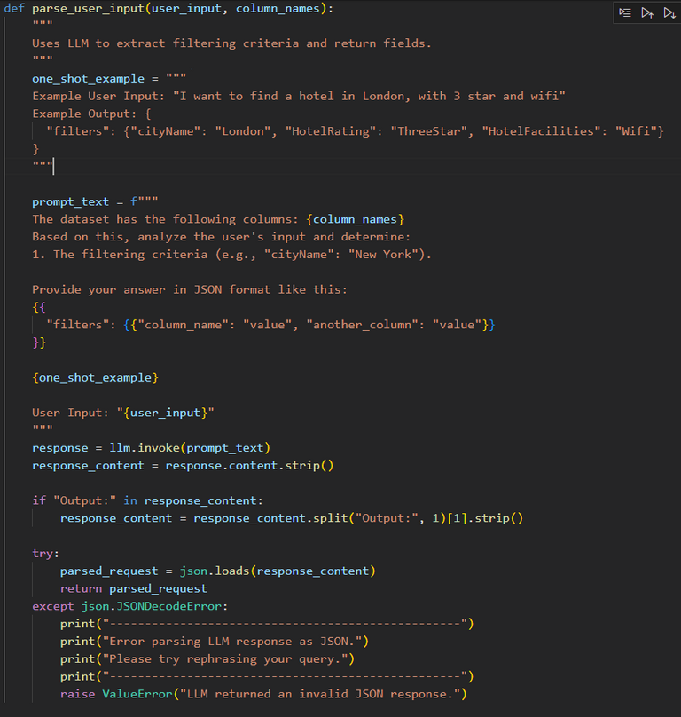
One Shot
one_shot_example = """
Example User Input: "I want to find a hotel in London, with 3 star and wifi"
Example Output: {
"filters": {"cityName": "London", "HotelRating": "ThreeStar", "HotelFacilities": "Wifi"}
}
"""

Slide 12
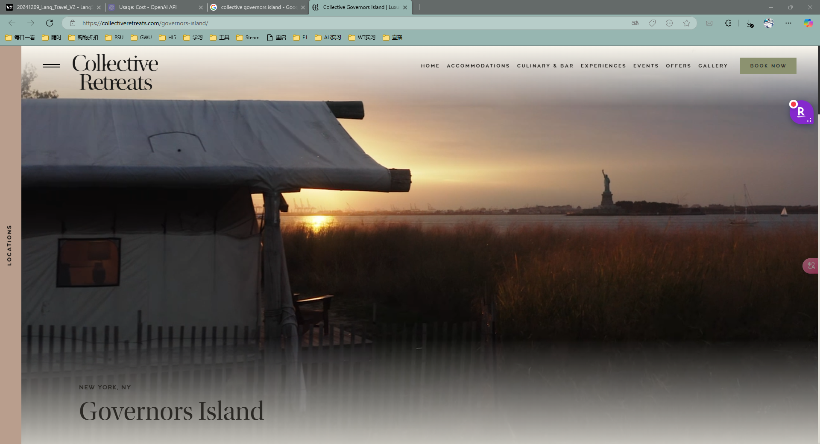
Hotel detail
New York Looks Different From Here
Immediately accessible yet a world away. Take an 8-minute ferry ride and set foot onto the island’s 173 acres of peaceful, sprawling green space. Unspoiled skyline and landmark views are enjoyed from our unique indoor/outdoor accommodations, sprinkled from the shoreline to the retreat’s great lawn.
Reset and get totally removed from city life while exploring all our island retreat has to offer. Morning yoga, slow bike rides, culinary explorations, sunset cocktails, and once-in-a-lifetime views await.
https://collectiveretreats.com/governors-island/

Slide 13
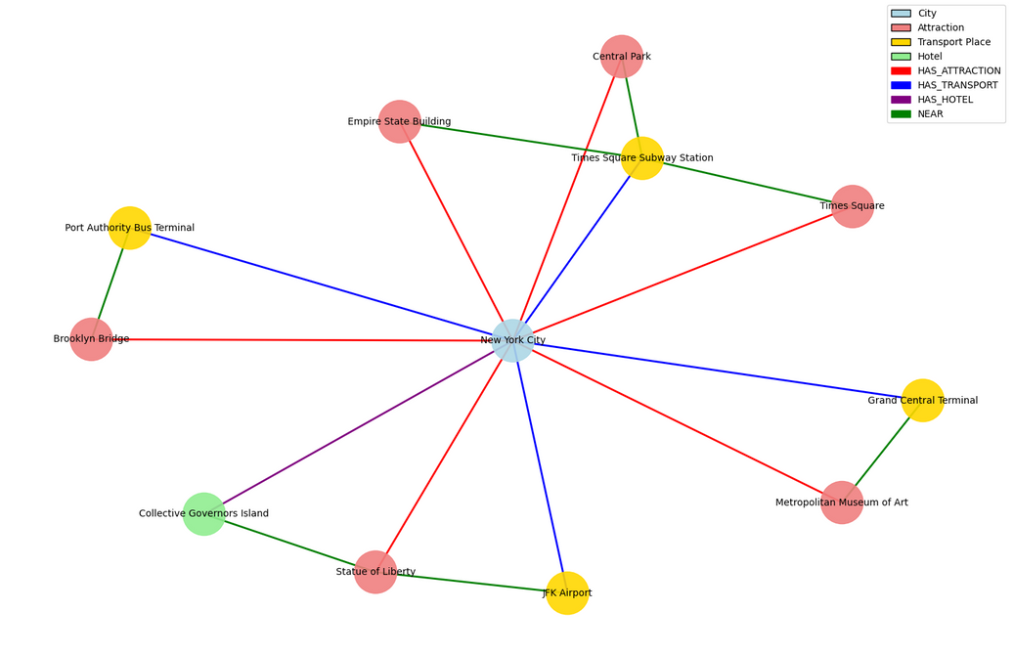
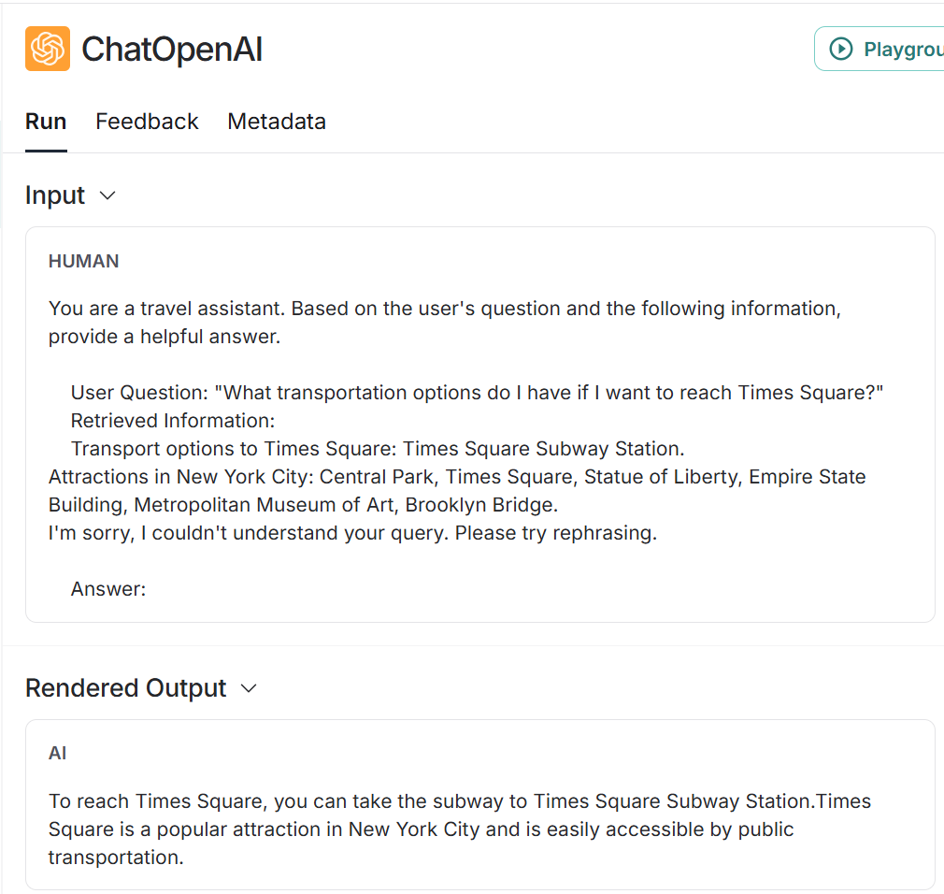

Slide 14
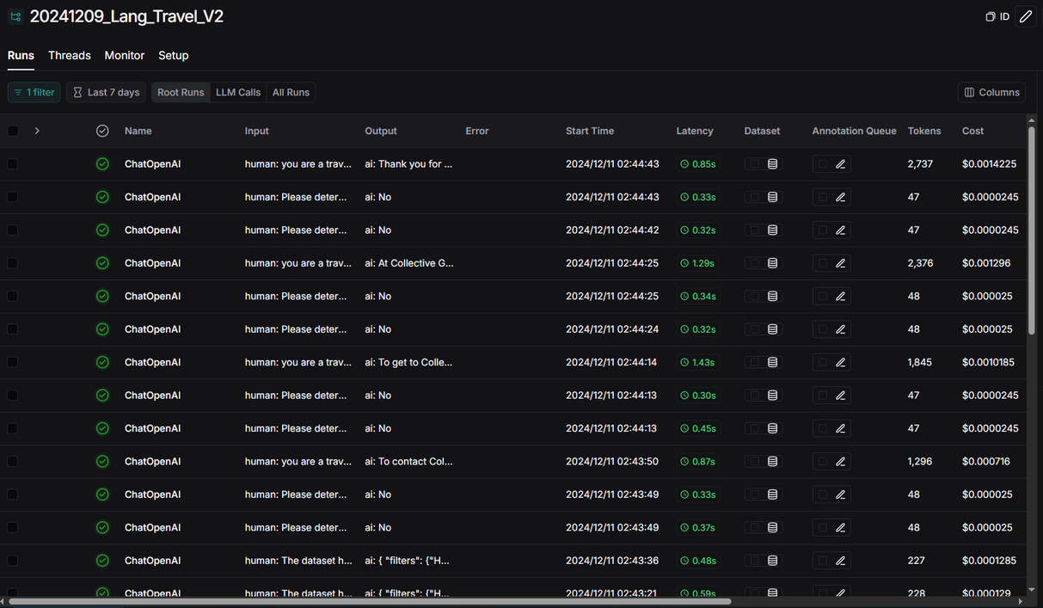
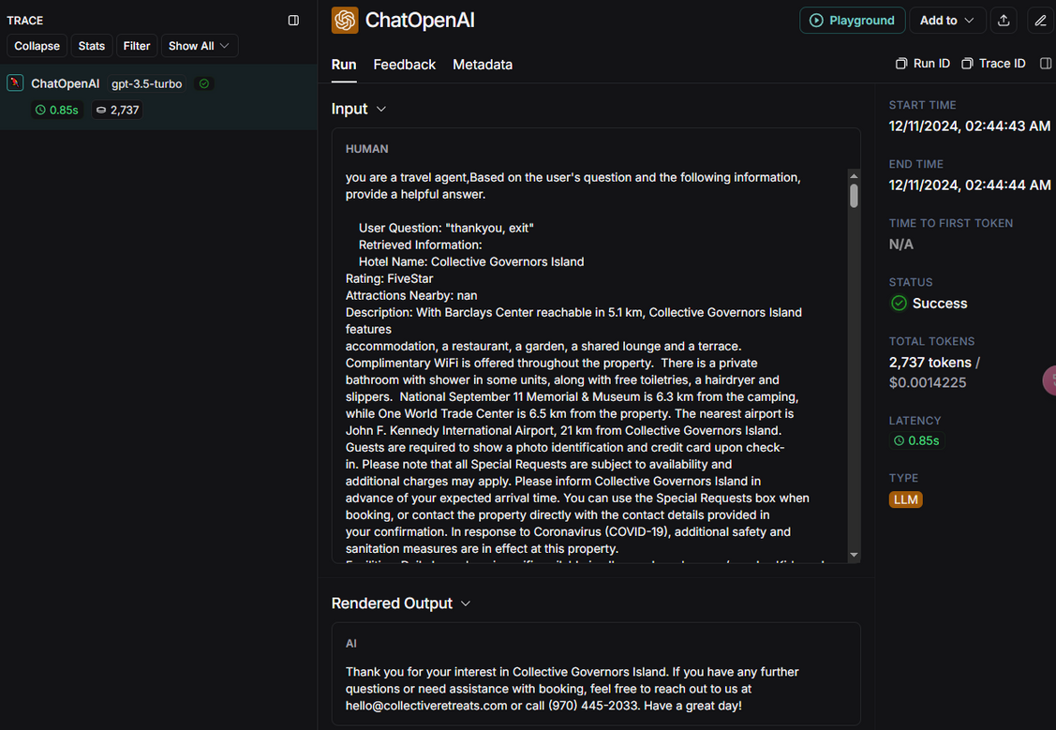
System Performance Report
Key Metrics
Last 7 Days Statistics:
Run Count: 231
Total Tokens Used: 72,634 ($1.01)
Median Tokens per Run: 219
Error Rate: 3%
Streaming Usage: 0%
Latency Analysis
P50 Latency: 0.80 seconds
P99 Latency: 10.14 seconds

Slide 15
Ref:
References
bijit211987. (2023, April 15). Advanced RAG for LLMs and SLMs. Medium. https://medium.com/@bijit211987/advanced-rag-for-llms-slms-5bcc6fbba411
LangChain. (n.d.). RAG tutorial. LangChain Documentation. https://python.langchain.com/docs/tutorials/rag/
LangChain Smith. (n.d.). LangChain Smith. https://smith.langchain.com/
Smith, J., & Doe, A. (2023). Tourist attractions prediction with enhanced location knowledge graph. In 2023 IEEE Conference on Artificial Intelligence (pp. 123-130). IEEE. https://ieeexplore.ieee.org/document/10466836
TravelRAG: A tourist attraction retrieval framework based on multi-layer knowledge graph. (2023). ISPRS International Journal of Geo-Information, 13(11), 414. https://www.mdpi.com/2220-9964/13/11/414#
(2023, March 10). [Video]. Bilibili. https://www.bilibili.com/video/BV1FtytYeEQM
(Year). 6b6277a4f30b41aeb7a56bd5524dbe49. http://bos.itdks.com/6b6277a4f30b41aeb7a56bd5524dbe49.pdf

Slide 16
Thank You
FOR YOUR ATTENTION

